Slide 1

Introduction to Economics
1ST SEMESTER
UNIT 8

Slide 2
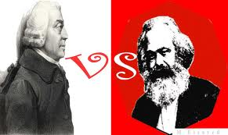
Which are the 2 main political/ economic systems that prevailed in the world in the last century?

Slide 3
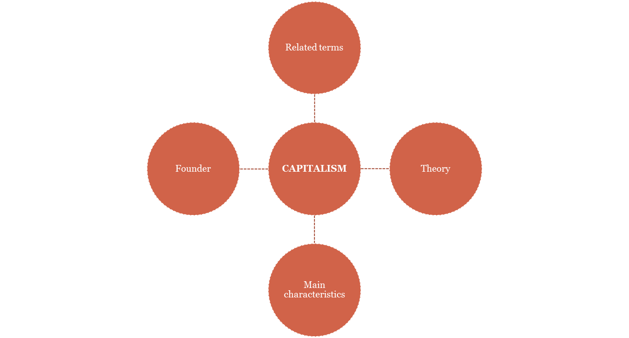

Slide 4
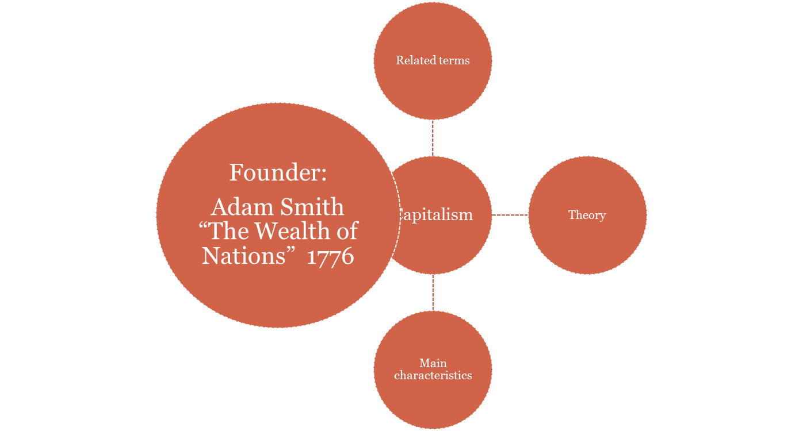
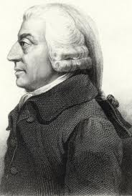

Slide 5
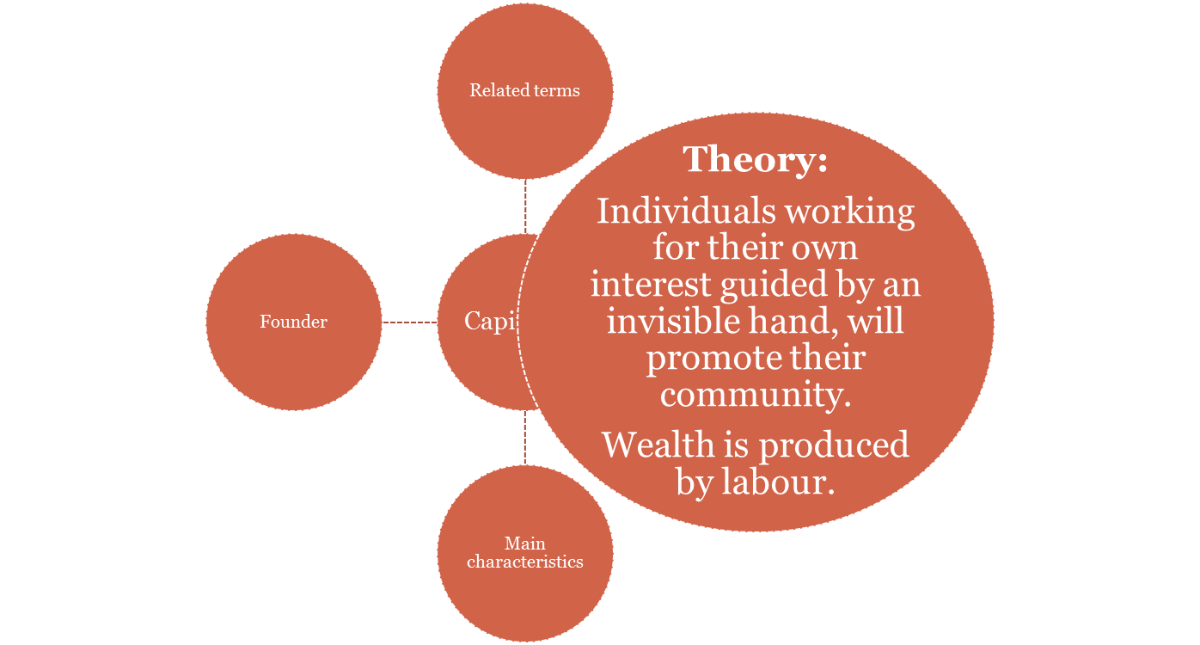

Slide 6
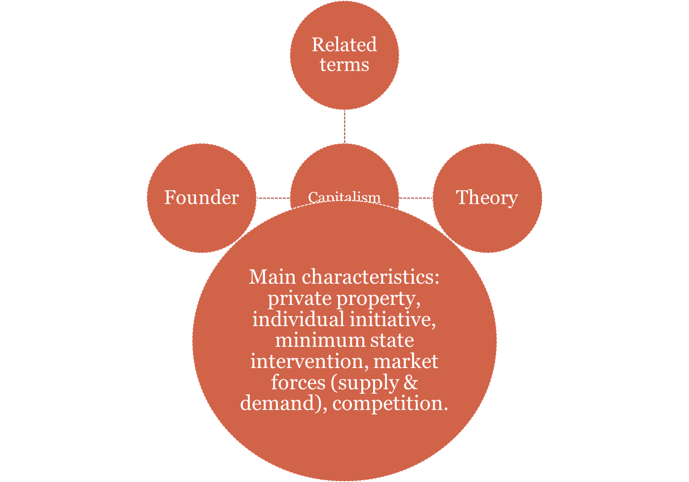

Slide 7
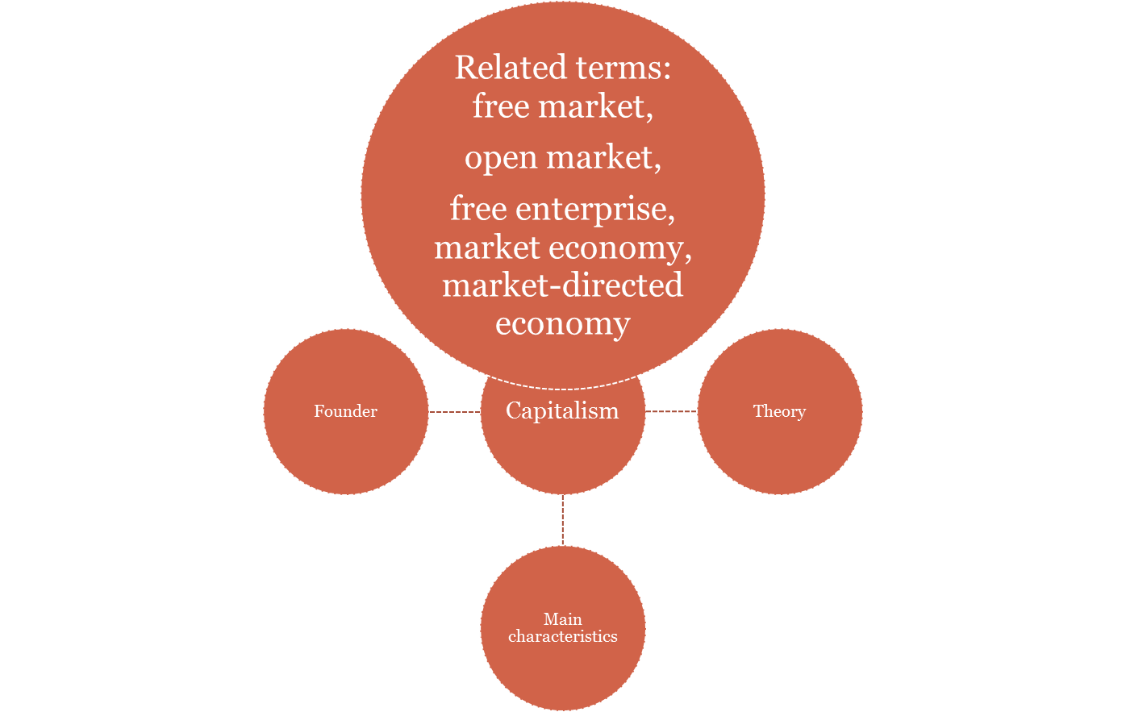

Slide 8
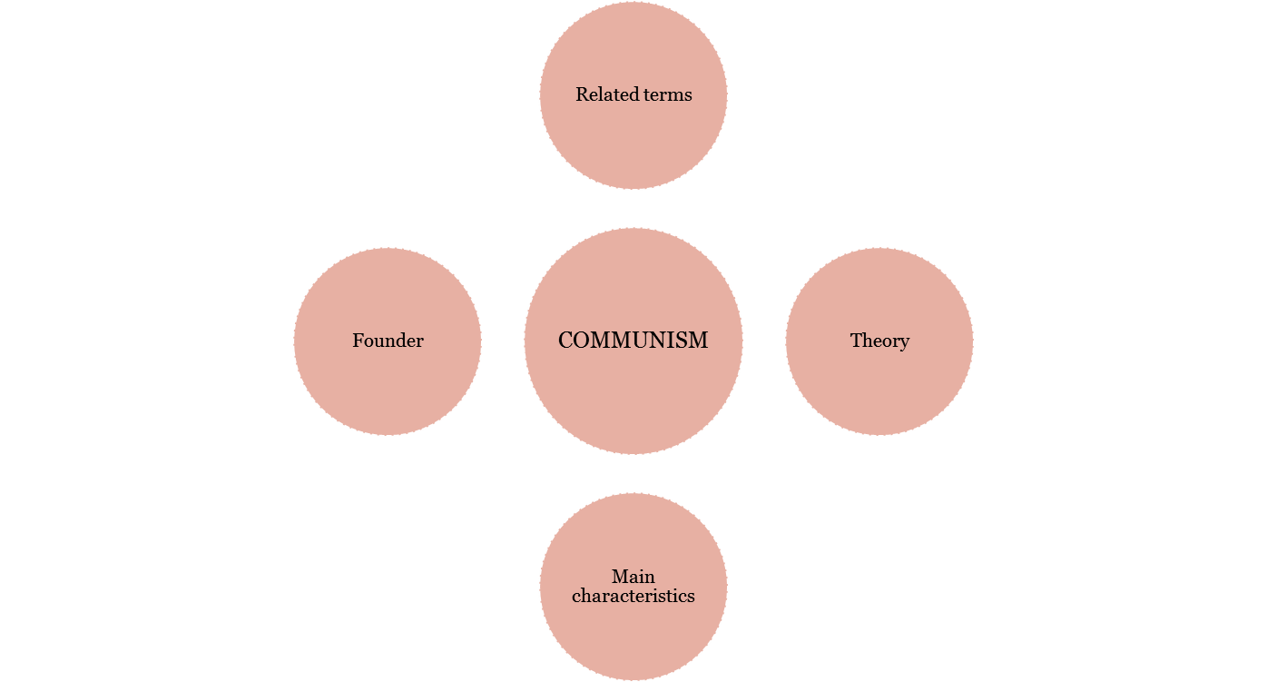

Slide 9
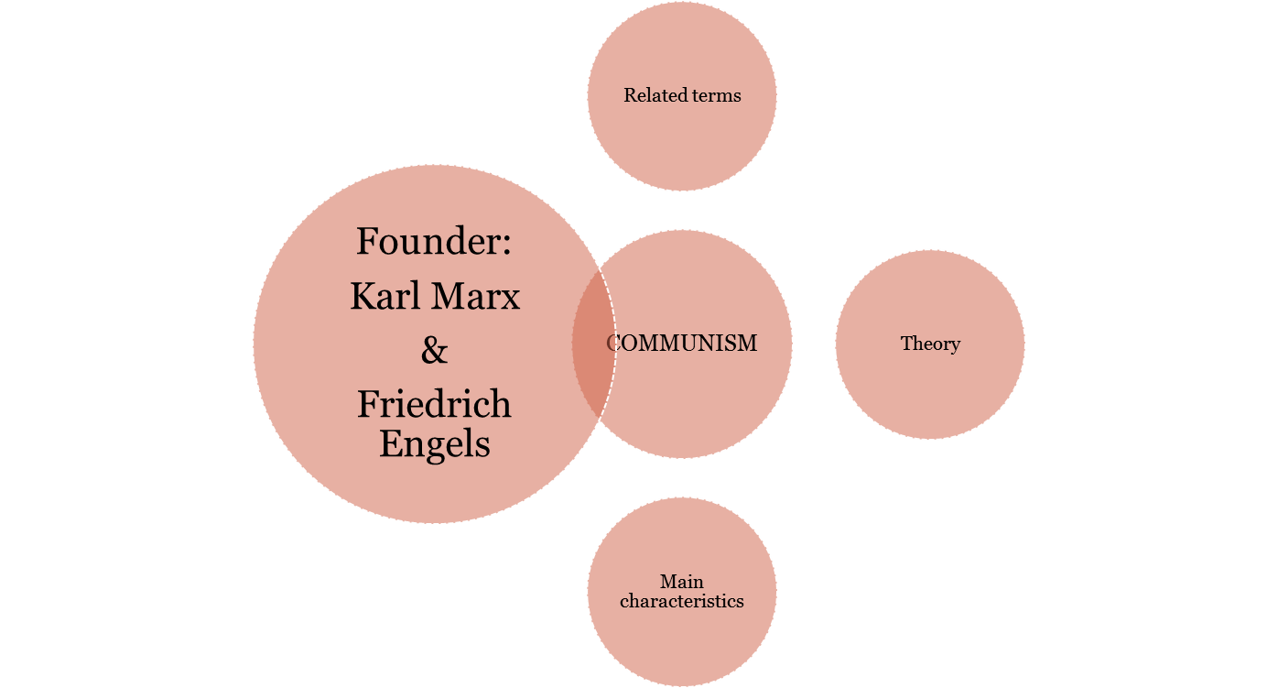
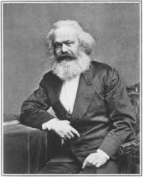

Slide 10
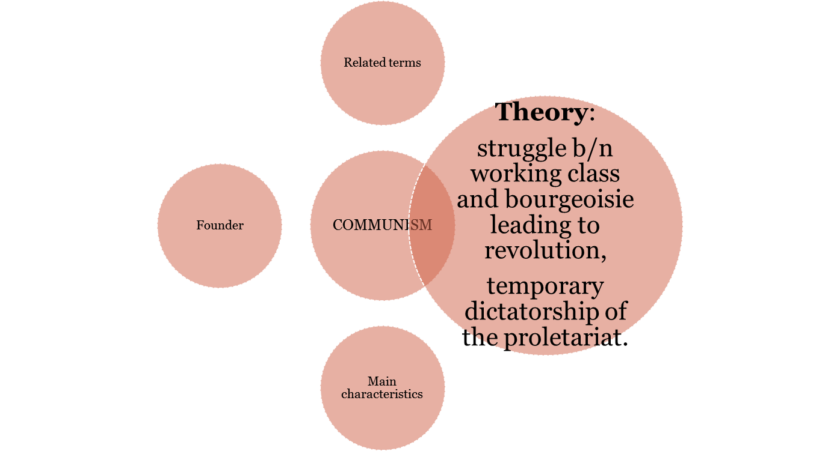

Slide 11
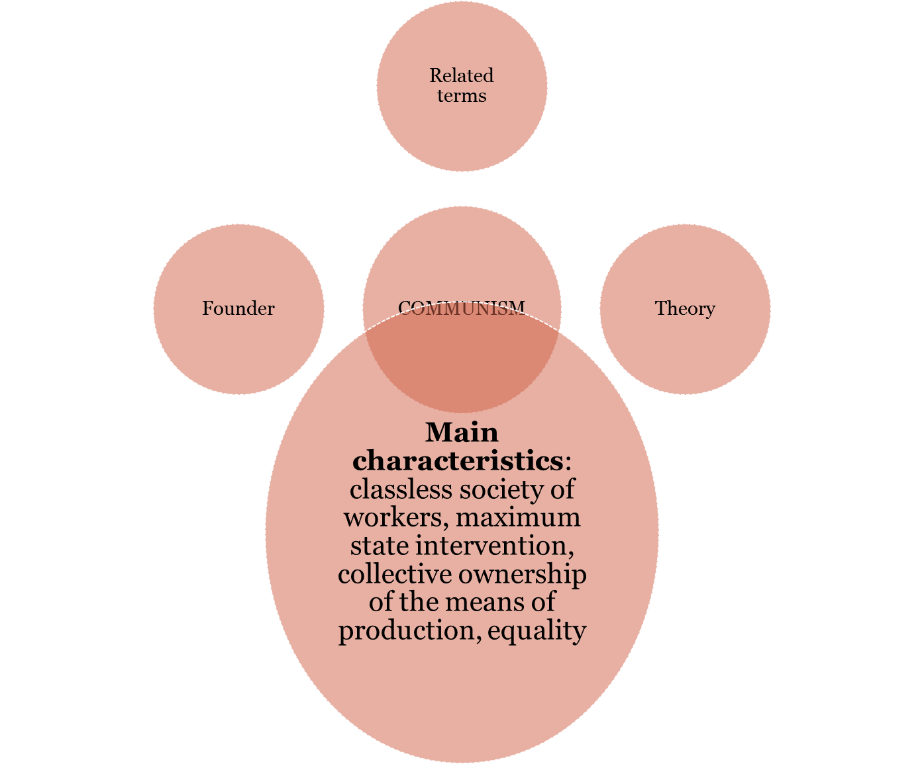

Slide 12
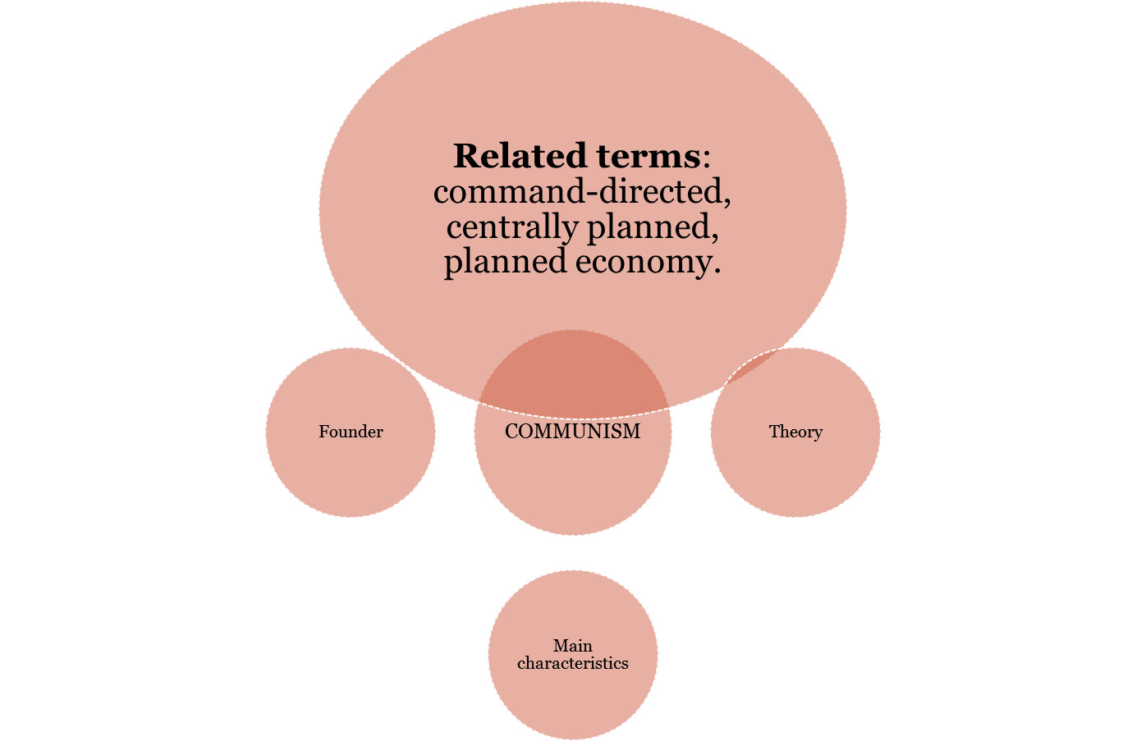

Slide 13
Game theory, Globalisation, information economics, informal economy, inflation, fiscal policy
The spending and taxing activities of a government constitute its _____.
_____ It is a major method used in mathematical economics and business for modeling competing behaviors of interacting agents. The term here implies the study of any strategic interaction between people. Applications include a wide array of economic phenomena, such as auctions, mergers & acquisitions, oligopolies, social network formation, and across such broad areas as experimental economics, behavioral economics, information economics, and political economy.
_____ A generalized historical process through which more economic activity takes place across national borders. It includes international trade (exports and imports), foreign direct investment, international financial flows, and international migration.

Slide 14
Game theory, Globalisation, information economics, informal economy, inflation, fiscal policy
_____ It is a branch of economic theory that studies how information and information systems affect and economic decisions. It has special characteristics which complicate many standard economic theories. It is easy to create but hard to trust. It is easy to spread but hard to control. It influences many decisions.
_____ This sector of the economy represents the production of goods and services for the own-use of the producers, or “underground” trade in particular communities. Other related terms are grey, shadow or underground economy.
___________ General increase in price levels, or fall in the value of money, over a period of time. When high, it reduces the value of people’s savings and damages the economy by pushing up the price of exports, which can lead to a balance of payments crisis.

Slide 15
Labour economics, Monetary policy,
The law of supply and demand, Productivity,
Opportunity cost, Economic equilibrium
_____ It seeks to understand the functioning and dynamics of the markets for wage labor. Its markets function through the interaction of workers and employers. It looks at the suppliers of labor services (workers), the demands of labor services (employers), and attempts to understand the resulting pattern of wages, employment, and income.
_____ It constitutes an economic model of price determination in a perfectly competitive market. It postulates that in a perfectly competitive market with no externalities, per unit taxes, or price controls, the price for a particular good is the price at which the quantity demanded by consumers equals the quantity supplied by producers. This price results in a stable _____.

Slide 16
Labour economics, monetary policy,
The law of supply and demand, productivity, opportunity cost
_____ It reflects the use by government agencies (esp the central bank) of interest rate adjustments and other levers (such as various banking regulations) to influence the flow of new credit into the economy, and hence the rate of economic growth and job-creation.
The _____ of any activity. It is the value of the next-best alternative thing you may have done instead. It depends only on the value of the next-best alternative.
_____ It measures the effectiveness or efficiency of productive effort. It is measured as the actual amount of a good or service produced in terms of the value of output, or as the amount of output produced over a certain period of work (e.g. output per hour).

Slide 17
Micro OR Macro-economic terms??
Economic equilibrium
Fiscal policy
Labour economics,
Game theory
Globalisation
Information economics
Informal economy
Inflation
Monetary policy
Opportunity cost
Productivity
The law of supply and demand

Slide 18
Micro OR Macro-economic terms??- KEY
MICRO
MACRO
The law of supply and demand
Economic equilibrium
Labour economics
Game theory
Information economics
Opportunity cost
Inflation
Fiscal policy
Informal economy
Productivity
Monetary policy
Globalisation

Slide 19
Word families
Verb | Noun-person | Noun | Adjective | Adjective-neg.
 |  | economics
employ
 |  | production
nationalize
 | governor

Slide 20
Verb | Noun-person | Noun | Adjective | Adjective-neg.
economize | economist | Economics economy | economic economical | non-economic uneconomical
employ

Slide 21
Verb | Noun-person | Noun | Adjective | Adjective-neg.
economize | economist | economics | economic economical | non-economic uneconomical
employ | employer employee | employment ≠ unemployment |  | unemployed

Slide 22
Verb | Noun-person | Noun | Adjective | Adjective-neg.
economize | economist | economics | economic economical | non-economic uneconomical
employ | employer employee | employment ≠ unemployment |  | unemployed
Produce | Producer | Production Productivity Product produce | Productive | unproductive counterproductive

Slide 23
Verb | Noun-person | Noun | Adjective | Adjective-neg.
economize | economist | economics | economic economical | non-economic uneconomical
employ | employer employee | employment ≠ unemployment |  | unemployed
Produce | Producer | Production Productivity (product, produce) | Productive | unproductive
nationalize | Nationalist | Nationality nationalism | National international

Slide 24
Verb | Noun-person | Noun-abstract | Adjective
govern | governor | government governance | governing

Slide 25
Word families
Verb | Noun-person | Noun-abstract | Adjective | Adjective-neg.
 |  |  |  | non-competitive
 |  |  | industrious
 | owner
 |  |  | social
manage

Slide 26
Verb | Noun-person | Noun | Adjective | Adjective-neg.
Compete | Competitor | Competition | competitive | non-competitive

Slide 27
Verb | Noun-person | Noun | Adjective | Adjective-neg.
Compete | Competitor | Competition | competitive | non-competitive
Industrialize | Industrialist | Industry | Industrious industrial | Non-industrial

Slide 28
Verb | Noun-person | Noun | Adjective | Adjective-neg.
Compete | Competitor | Competition | competitive | non-competitive
Industrialize | Industrialist | Industry | Industrious industrial | Non-industrial
own | owner | Ownership

Slide 29
Verb | Noun-person | Noun | Adjective | Adjective-neg.
Compete | Competitor | Competition | competitive | non-competitive
Industrialize | Industrialist | Industry | Industrious industrial | Non-industrial
own | owner | Ownership
Socialize | Socialist | Socialism Socialization society | Socialistic Social, Sociable

Slide 30
Verb | Noun-person | Noun | Adjective | Adjective-neg.
Compete | Competitor | Competition | competitive | non-competitive
Industrialize | Industrialist | Industry | Industrious industrial | Non-industrial
own | owner | Ownership
Socialize | Socialist | Socialism | Social, socialistic Sociable
manage | Manager | Management | managerial

Slide 31


